Slide 1
Discussion today: Grating couplers
Today we will discuss how we can couple light between optical fibers and on-chip photonic waveguides. In particular we will focus on grating couplers.
Today we will cover the theory of grating couplers. Next week we will put the theory to use and design a silicon photonic grating coupler.

Slide 2
Coupling into and out of waveguides
Dilemma: how do we couple light to and from an optical fiber to an integrated on-chip photonic waveguide?
400nm
10$μm$
Optical fiber
On-chip waveguide
(to scale)

Slide 3
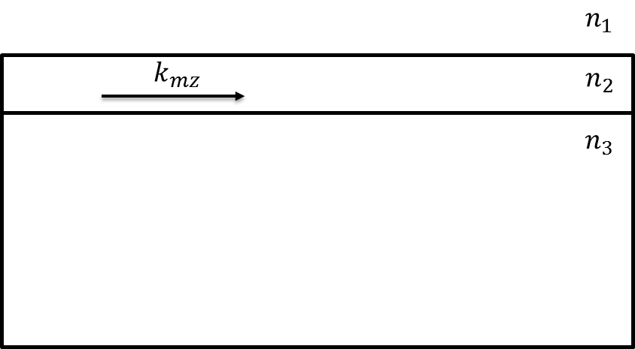
End-fire coupling
Pros: Coupling efficiency can be very good
Cons: Poor tolerance to misalignment. Costly to manufacture.
Optical fiber (not to scale)
lens
photonic waveguide
Side view

Slide 4
Nanotaper coupler
Pros: Coupling efficiency can be very good. Lens not needed
Cons: Poor tolerance to misalignment. Requires advanced lithography equipment
Taper to ~100nm → spatial extent of mode becomes large
(n_{eff} ~ n_{cladding} -> low confinement factor)
Optical fiber (not to scale)
Single mode silicon waveguide
Top view

Slide 5
Top coupling?
How can we couple light from a confined waveguide mode to an optical fiber placed above the waveguide?
Optical fiber (not to scale)
$$x$$
$$n_{1}$$
$$n_{2}$$
$$k_{mz}$$
$$z$$
$$n_{3}$$

Slide 6
Grating coupler
By periodically notching the waveguide we can make a diffraction grating such that light that is diffracted off the rulings will constructively interfere toward a direction into the optical fiber
Optical fiber (not to scale)
$$x$$
$$n_{1}$$
$$n_{2}$$
$$k_{mz}$$
$$a$$
$$z$$
$$n_{3}$$

Slide 7
Grating coupler
We choose the diffraction period ($a$) such that scattering from individual rulings constructively interferes at the desired angle
Optical fiber (not to scale)
Scattering from individual ruling
$$x$$
$$n_{1}$$
$$n_{2}$$
$$k_{mz}$$
$$a$$
$$z$$
$$n_{3}$$

Slide 8
Grating coupler
We can write a relationship between the diffraction angle ($θ$) and the periodicity ($a$) of the grating
$$θ$$
$$x$$
$$n_{1}$$
$$n_{2}$$
$$k_{mz}$$
$$a$$
$$z$$
$$n_{3}$$

Slide 9
Let’s use ray optics to determine the condition for two rays reflected off adjacent rulings to constructively interfere at an angle $θ$.
We choose grating periodicity ($a$) such that the path length difference ($b$) results in constructive interference between Ray 1 and Ray 2.
This will happen when phase difference between Ray 1 and Ray 2 are integer multiples of 2π.
Ray 1
Ray 2
$$b$$
$$θ$$
$$a$$
$$n_{1}$$
$$n_{2}$$
$$k_{mz}$$

Slide 10
Phase of Ray 2
Phase of Ray 1
$$k_{mz}a−k_{1}b=2πm$$
$$m=0,±1,±2…$$
Ray 1
$$\frac{2π}{λ}n_{eff}a−\frac{2π}{λ}n_{1}b=2πm$$
Ray 2
$$n_{eff}a−n_{1}b=mλ$$
$$b$$
$$θ$$
$$n_{eff}a−n_{1}a sin⁡(θ)=mλ$$
$$a$$
$$n_{1}$$
$$n_{2}$$
$$\sin\left(θ\right)=\frac{mλ−n_{eff}a}{{−n}_{1}a}$$
$$k_{mz}$$
$$\sin\left(θ\right)=\frac{n_{eff}−\frac{mλ}{a}}{n_{1}}$$

Slide 11
Coupling into waveguide
By reciprocity we can use the same grating to couple light into a waveguide.
But, let’s examine this problem slightly differently.
Optical fiber (not to scale)
$$x$$
$$n_{1}$$
$$n_{2}$$
$$k_{mz}$$
$$a$$
$$z$$
$$n_{3}$$

Slide 12
Waveguide coupling
What if I send light onto a waveguide (without a grating) as shown below?
How much power can I couple into the waveguide?
$$x$$
$$θ$$
$$n_{1}$$
$$z$$
$$n_{2}$$
$$k_{mz}$$
$$n_{3}$$

Slide 13
Waveguide coupling
The answer is precisely zero!
$$x$$
$$θ$$
$$n_{1}$$
$$z$$
$$n_{2}$$
$$k_{mz}$$
$$n_{3}$$

Slide 14
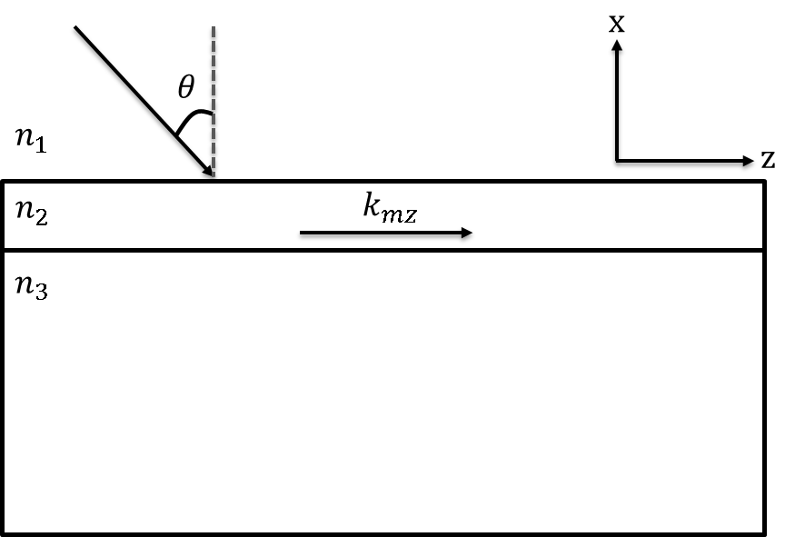
Waveguide coupling
Let’s do the math:
At the air-waveguide interface (x = 0), the tangential component of electric field must be continuous:
This implies a phase matching condition:
$E_{inc}=\hat{y}E_{0}e^{−j(k_{1z}z−k_{1x}x)}$ (incident)
$E_{R}=\hat{y}E_{R}e^{−j(k_{1z}z+k_{1x}x)}$ (reflected)
$E_{m}=\hat{y}E_{m}e^{−j(k_{mz}z+k_{mx}x)}$ (transmitted)
$$E_{0}e^{−jk_{1z}z}+E_{R}e^{−jk_{1z}z}=E_{m}e^{−jk_{mz}z}$$
$$k_{1z}=k_{mz}$$

Slide 15
Waveguide coupling
We can write $k_{1z}$ as:
Therefore:
But, for a guided mode we know that that the effective index must be greater than $n_{1}$ and as a result $k_{mz}=k_{0}n_{eff}>k_{0}n_{1}$ This requires $\sin{θ_{m}>1}$ which is of course impossible!
We cannot couple light into a guided mode without dealing with this phase match condition.
$$k_{1z}=k_{0}n_{1}\sin{θ_{m}}$$
$$k_{0}n_{1}\sin{θ_{m}=k_{mz}}$$

Slide 16
Waveguide coupling
Another way of seeing this is to recall that a guided mode must decay exponentially away from the core. In other words, $k_{x}$ is imaginary in the cladding. (If $k_{x}$ is real, it is radiating!)
But incident mode must have real $k$ components, so cannot couple to guided mode.
Can we create an evanescent mode from incident mode?

Slide 17
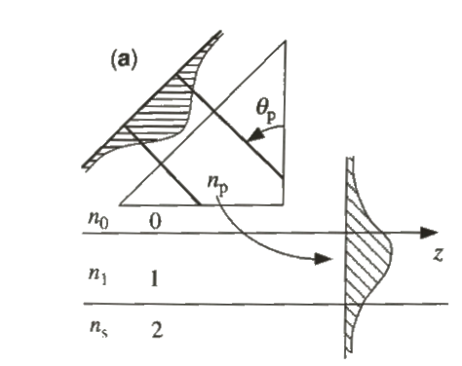
Prism couplers
Can use prism placed close to waveguide to satisfy phase matching condition
Evanescent mode in $n_{0}$ region couples to guided mode
Same mechanism used in beamsplitters
Used mainly for refractive index measurement of thin films (eg. metricon in Nanolab)
$${k_{z,prism}=k}_{0}n_{p}\sin\left(θ_{p}\right)=k_{1z}$$
$$n_{p}>n_{0}$$
$$θ_{p}>θ_{c} \left(critical angle\right)$$

Slide 18
Grating coupler
What if we have the following geometry?
$$x$$
$$θ$$
$$n_{1}$$
$$z$$
$$n_{2}$$
$$k_{mz}$$
$$a$$
$$n_{3}$$

Slide 19
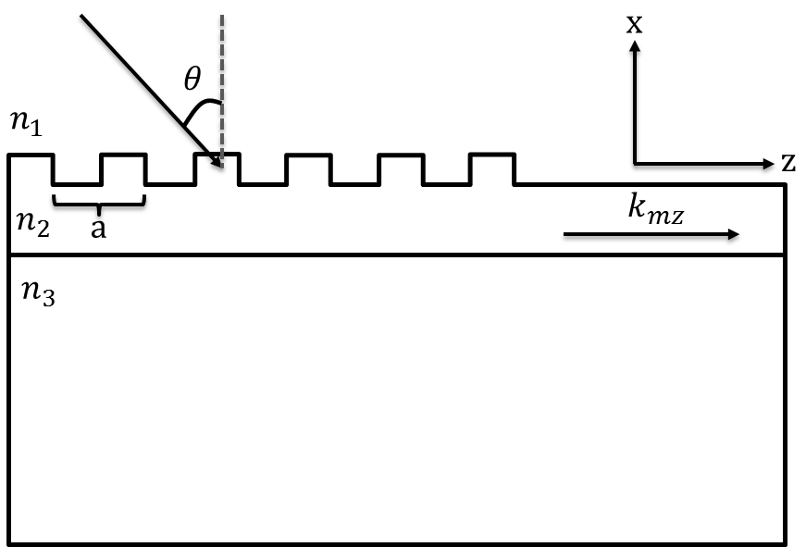
Grating coupler
At the boundary of $n_{1}$ and $n_{2}$ we can write
$h\left(z\right)$ is a periodic function describing the height variation of our grating. Thus we can write $e^{−jk_{1x}h\left(z\right)}$ using a Fourier series
$$E_{0}e^{−j(k_{1z}z−k_{1x}h\left(z\right))}+E_{R}e^{−j(k_{1z}z+k_{1x}h\left(z\right))}$$ $=E_{m}(x,y)e^{−jk_{mz}z}$
$$e^{−jk_{1x}h\left(z\right)}=\sum_{m=−∞}^{m=∞}{A_{m}e^{−jm\left(\frac{2π}{a}\right)z}}$$

Slide 20
Grating coupler
At the boundary of $n_{1}$ and $n_{2}$ we can write
Now our new phase matching requirement is:
for some $m, n$.
Clearly, $m=n$, therefore:
$$E_{0}e^{−jk_{1z}z}\sum_{m=−∞}^{m=∞}{A_{m}e^{−jm\left(\frac{2π}{a}\right)z}}+$$
$$E_{R}e^{−jk_{1z}z}\sum_{n=−∞}^{n=∞}{A_{n}e^{−jn\left(\frac{2π}{a}\right)z}}$$
$=E_{m}(x,y)e^{−jk_{mz}z}$
$$k_{1z}+{2πm}/a=k_{1z}+{2πn}/{a=k_{mz}}$$
$$k_{0}n_{1}\sin{θ+{2πm}/a=k_{mz}}$$

Slide 21
Grating coupler
This is the same phase matching requirement that we derived under the ray optics model.
By properly choosing $m$ and $a$ we can now phase match!
$$k_{1}\sin{θ}+2πm/a=k_{mz}$$

Slide 22
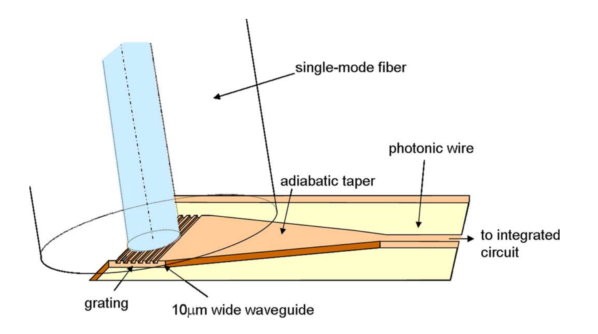
Grating examples

Slide 23
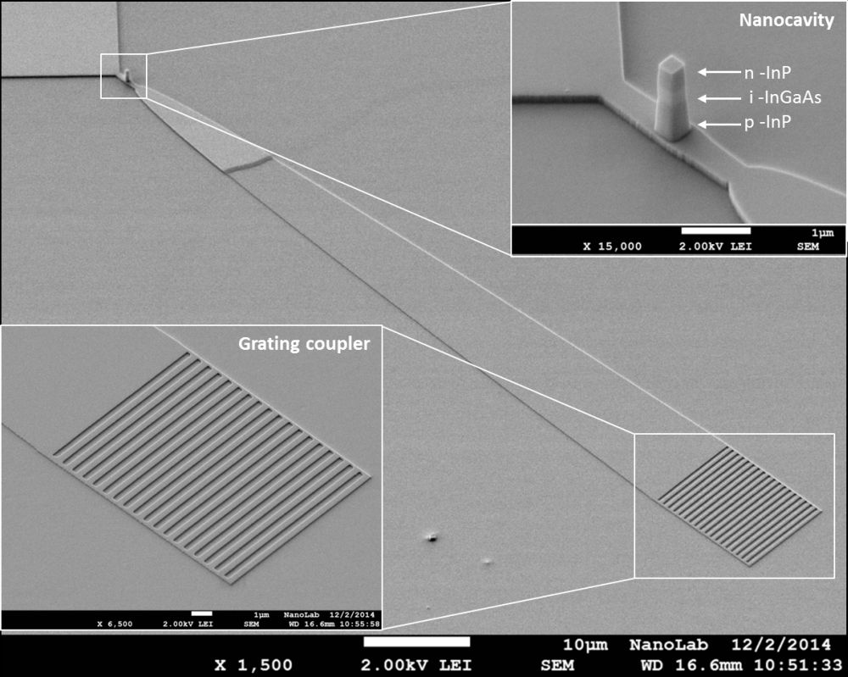
http://www.oxford-instruments.com/businesses/nanotechnology/plasma-technology/campaigns/sem-competition-winner-%281%29

Slide 24
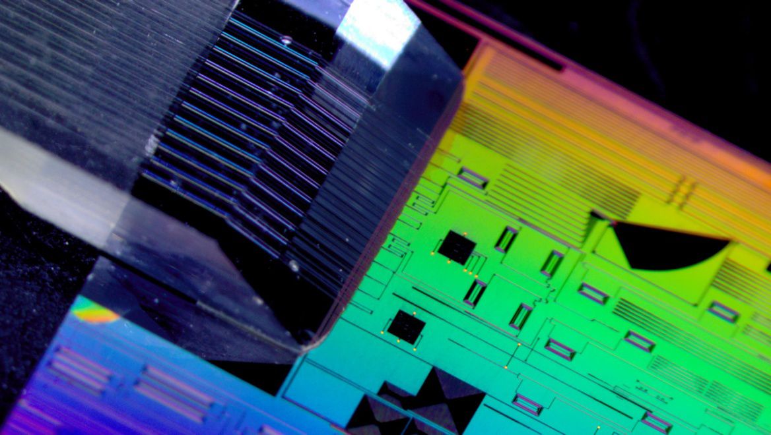
Source: Imec

Slide 25
Design example
Design the grating period such that light is diffracted out at a 10° angle for 1st order diffraction
Assume $n_{eff}=2.5, λ=1.55μm$
10°
$$\sin\left(θ\right)=\frac{n_{eff}−\frac{λ}{a}}{{n_{air}}_{ }}$$
$$air$$
$$silicon$$
$$a$$
$$\sin\left(10°\right)=\frac{2.5−\frac{1.55}{a}}{1_{ }}$$
$$SiO_{2}$$
$$a \sim 670 nm$$

Slide 26
Comments
Today we have shown how to calculate the diffraction angle of a grating coupler but we have not said anything about the intensity of the light that will diffract at that angle – in other words we do not yet know the coupling efficiency.
This requires more rigorous theory or simulation tools.
Next class: Numerical design of a grating coupler using Lumerical FDTD

